Slide 1
Welcome to SWWC!

Slide 2
Authorized by MN Statute as a regional resource for our members, we are a public agency that provides a comprehensive range of educational and administrative programs and services to our members. For more than 50 years, we have partnered with our members to bring equity and opportunity to our region.
Who We Are

Slide 3
Who We Are
Mission: To be a collaborative partner providing exceptional services, innovation solutions and proactive support.
Vision: To create a future where children, families, schools and communities learn, succeed and thrive.

Slide 4
Our Value Statements
SWWC believes in service to others. We care about the success of those we serve and those we employ. We work to anticipate the needs of others and collaboratively implement innovation solutions.
SWWC believes integrity is the foundation of our actions. We are honest, trustworthy, transparent and ethical. We are committed to doing the right thing.
SWWC encourages sincerity. We believe in open and honest communication. We welcome everyone’s contributions and ideas.
SWWC believes collaboration aids innovation and creativity, improving our ability to provide exceptional services.

Slide 5
How We Operate
SWWC is governed by a 9-member board.
Elected by our membership, board members throughout the
18-county service region are strong advocates in our communities.
While SWWC is an essential part of state and regional education services, we do not receive state or local tax dollars to fund our programs and services.
Operating revenue is derived from membership fees and grants.

Slide 6
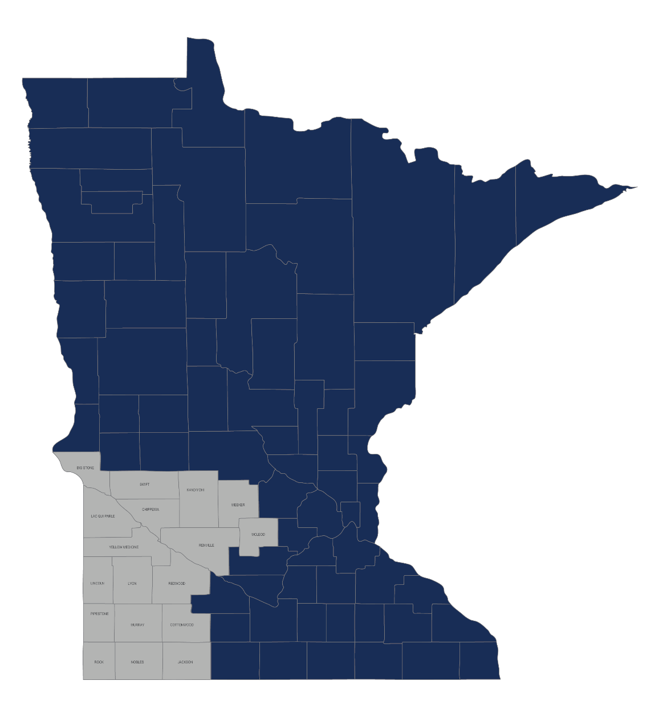
Service Area
Who We Serve
Our geographic boundaries cover the 18 counties of southwest and west central Minnesota, but our programs and services span beyond those boundaries.

Slide 7
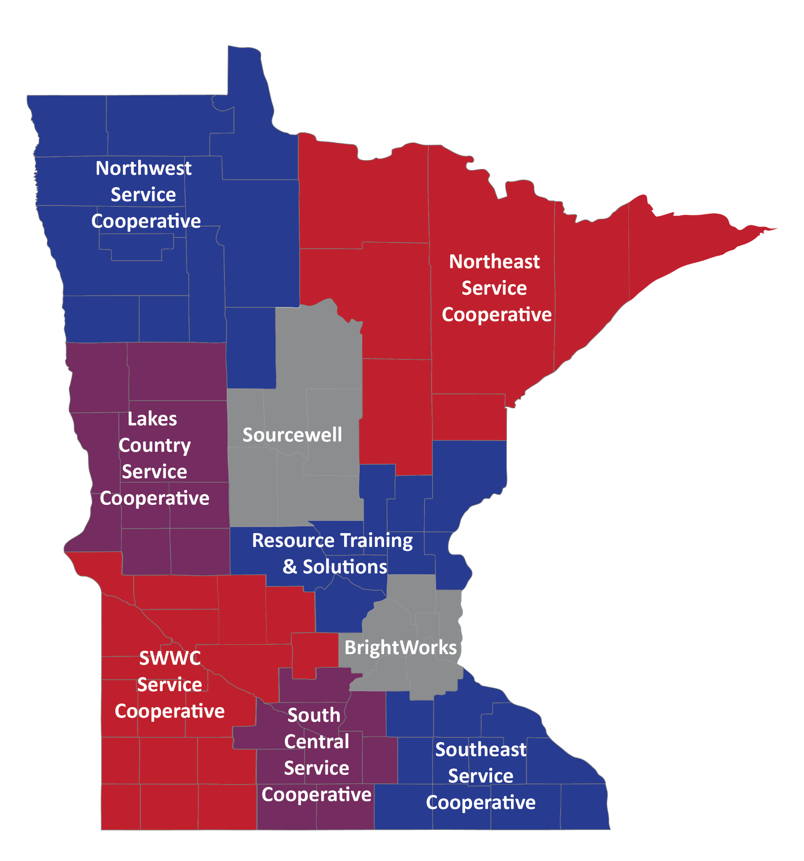
SWWC is a member of the Minnesota Service Cooperatives, an association of nine educational service agencies in Minnesota.
Notes:
…

Slide 8
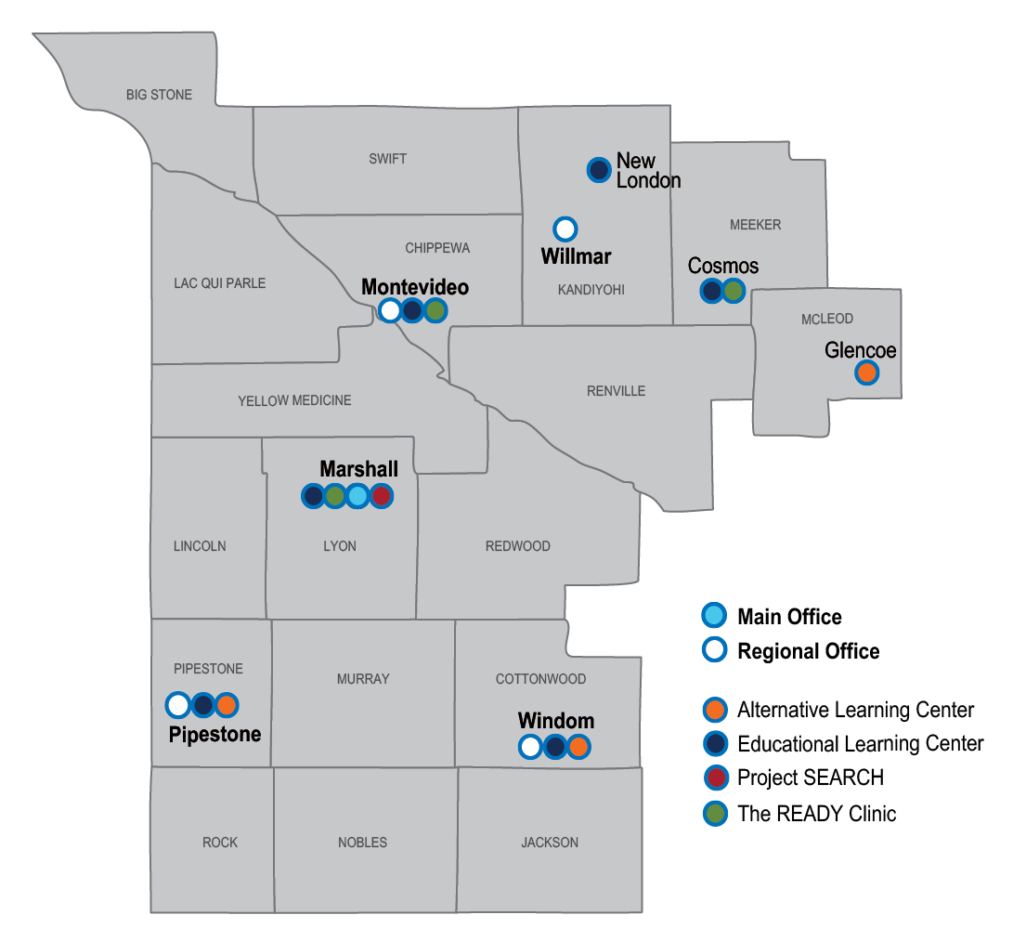
Description of the Region
First in MN - Created in 1965
18 counties (regions 6E, 6W & 8)
12,500 square miles
Over 400 employees
Over 46,000 students in region
Some services expand beyond regional boundaries

Slide 9
Membership
FULL MEMBERSHIP is open to all public school districts, cities, counties and other governmental agencies within our 18-county region.
ASSOCIATE MEMBERSHIP is open to:
non-public schools and other partnership agencies and organizations within our region and
public and non-public schools, cities, counties, partnership agencies, non-profit organizations and other governmental agencies outside our region.

Slide 10
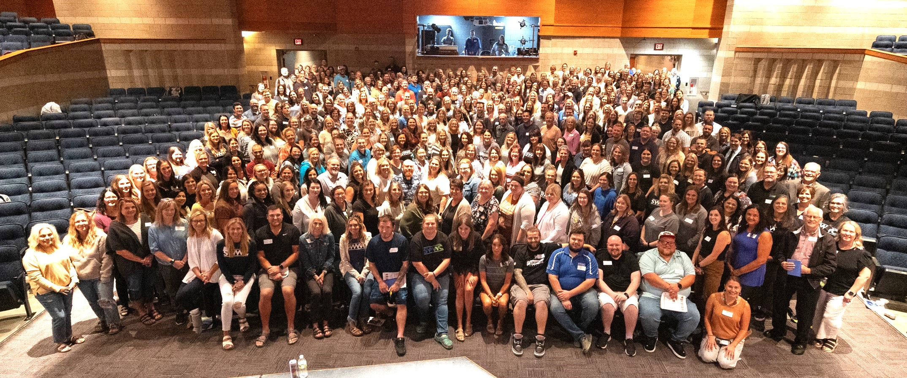
GREAT people doing GREAT things!

Slide 11
Executive Leadership Team

Slide 12
What We Do

Slide 13
Educational Services
Behavioral Health Services | Special Services | Teaching & Learning Services
Behavioral Analytic Services Mental Health Services School Health Services Interpreter/Translator Services The READY Clinic School Crisis Response Team | Special Education Administrative Services Direct Student Services - DAPE, OT, School Psychologist, SPED teacher, DHH, O&M, EC teacher, PT, School Social Worker, SLP, VI Educational Learning Centers - Setting IV (six sites across the region) Project SEARCH Low Incidence Services | T&L Curriculum & Instruction Services Structured Literacy Services PBIS Multilingual Learning Services Carl Perkins, Rural CTE, LYFT Pathways, Project Discovery, Student Enrichment SLEDS grant New Teacher Center & Instructional Coaching Alternative Learning Centers (three sites across the region) STARRS Online Academy

Slide 14
Administrative Services
Business Services | Technology Services | Other Administrative Services
RMIC Business Services (Accounting, HR, Payroll) RMIC SMART Systems MARSS Health & Safety Program Annual School Business Conference | Technology Leadership & Support Staffing/ Services Technology Integration Staffing and Services Wide Area Network Consortium Distance Learning Facilitation (ITV and LMS) E-Rate Coordination Cybersecurity Staffing and Services Data Privacy Program Equipment, Software & Subscription Sales Annual Technology Conferences | City/County/Other Governmental Agency Health Insurance Pool School Health Insurance Pool Wellness Program Minnesota Healthcare Consortium Cooperative Purchasing

Slide 15
Behavioral Health Services
Behavior Analytic Services
Provides support for teachers
Conducts observations, provides recommendations, trains out recommendations
Conducts Functional Behavioral Assessments
Creates Behavior Intervention Plans
Provides trainings for paraprofessionals, teachers, and building staff
Mental Health Services
Social skills groups
Individual/Group student therapy
Individual/Group staff therapy
Resiliency Training, Suicide Prevention Training, YMHFA
Case Consultation

Slide 16
Behavioral Health Services
Licensed School Nursing Services
Contracted LSN services to meet district needs
Hearing and Vision Screening
CPR/First Aid
LSN Mentor Program
Staff and Student Education
Health Services Assessment
Translation/Interpreter Services
Fee for service- rates lower than other providers
Simple amendment to contract, billed monthly as the service is used
Available for in person, virtual, and/or phone
Currently supporting Educational Learning Centers, The READY Clinic, and other districts

Slide 17
Behavioral Health Services
The READY Clinics
Early intensive behavioral and developmental interventions
Medical based model
Locations in Marshall, Montevideo and Cosmos
Serving children under the age of 7 diagnosed with autism or other related developmental disability
Diagnostic evaluations for medical diagnosis of autism available
Anyone can refer
Services covered by private insurance or medical assistance
Goal to help increase skills and independence

Slide 18
Business Services
Smart Systems and Smart eR- Payroll and Finance
Centralized expertise in a broad range of services including finance, human resources and payroll
MARSS- MN Automated Reporting Student System
Support to staff working with student reporting
SWWC- Health and Safety Program
Evaluation, recordkeeping and training assistance to keep your school compliant with OSHA and Fire Code regulations

Slide 19
Business Services
Professional Development
Payroll
Calendar Year End
Fiscal Year End
ACA
Finance
Tax Levy
Budgeting
Fiscal Year End
MARSS
MARSS 101
MARSS Back to School
Annual Business Conference
Sessions with MDE, auditors, PERA, TRA, Regional Staff
Notes:
One of the things we do is we offer several educational sessions throughout the year
For Finance we offer trainings on
Tax Levy
Budgeting
Fiscal Finance Year End- think everyone’s favorite the annual audit
For Payroll- We offer trainings on
Calendar Year End – think W2,
Fiscal Year End – think teacher payoffs (summer payouts)
Affordable Care Act reporting- ACA reporting
MARSS Minnesota Automated Reporting Student System
We offer a “101”-Beginner session for new people or those wanting a refresher on student reporting requirement
And a back to school workshop
We also host an annual Spring Conference – which is a Full day of learning opportunities for schools in all 3 areas where we have MDE staff, auditors, PERA, TRA, Regional staff, and our Smart Systems programmers present.

Slide 20
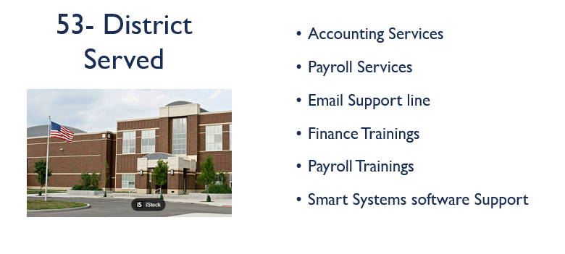
Business Services

Slide 21
Risk Management
Insurance Offerings
Minnesota Healthcare Consortium (MHC)
Member-Owned (Joint Powers) Self-Insured Health Insurance Pool (Medica)
Dental Insurance (Delta Dental)
Vision Insurance (VSP)
Regional Wellness Support
Medical Spending Account Administration (WEX)
HSA/VEBA Administration
Flexible Spending Accounts

Slide 22
Special Education
Special Education Administrative Services
Directors of Special Education
Assistant Directors of Special Education
Staff Development and Low Incidence Administrator
Due Process Specialists
Early Childhood Coordinators
Third Party Billing

Slide 23
Special Education
Special Education Direct Student Services
DAPE Teacher Early Childhood Teachers
Occupational Therapy Physical Therapy
School Psychology School Social Worker
Special Education Teacher Speech Language Pathology
Teacher of DHH Teacher of Visually Impaired
Orientation and Mobility

Slide 24
Special Education
Educational Learning Centers
Serves students with severe disabilities with diagnosis of Autism Spectrum Disorder or severe cognitive delays and students with severe behavioral issues.
ELC – Cosmos
ELC - Marshall
ELC - Montevideo
ELC – New London
ELC - Pipestone
ELC - Windom

Slide 25
Teaching & Learning
COMPASS Regional Network
Curriculum & Instruction Coordination Services
Literacy Lead Specialist Service
Literacy Services
Shared Services/Curriculum and Instruction Coordination
Positive Behavioral Interventions and Supports (PBIS)
T&L Customized Services
Instructional Coaching Implementation & Support
Carl Perkins Career Tech Ed
Project Discovery
LYFT Career Pathways
Student Enrichment
SLEDS Grant
Multilingual Learning Services
Alternative Learning Centers
STARRS Online Academy

Slide 26
T&L Support to ELCs/ALCs
Instructional Coaching
Multilingual Learning Services
MnMTSS Coordinator to support SWWC's ELCs and ALCs
Work-Based Learning Coordinator supporting the ALCs
ALC will have support from Stronger Connections grant work

Slide 27
COMPASS
2024-25: COMPASS Regional Network
In collaboration with MDE and MSC
SWWC Regional Team consists of: Regional MnMTSS Lead, Culturally Responsive Instructional Leadership Lead, Regional Literacy Lead, Literacy Network Coaches, Regional Math Lead, Equitable Access Specialist – Special Education focus, Statewide Advocate Lead, and School Advocates

Slide 28
Alternative Learning Centers
2024 Graduation = 71 students
ALC – Glencoe: 13 students from two different districts
ALC – Pipestone: 29 students from four different districts
ALC – Windom: 29 students from 14 different districts
Several of our graduates have been accepted to 2-year or 4-year college programs!

Slide 29
STARRS Online Academy
2023-24
Helped over 200 K-12 students across the state achieve their potential through individualized educational opportunities.

Slide 30
Career & Technical Education
Minnesota West Consortium = $665,000+ in funding
CTE Student Events: Career Expo, Culinary Skills Challenge, Major Madness and Photography Competition
LYFT Career Pathways continues to fund projects throughout the region.

Slide 31
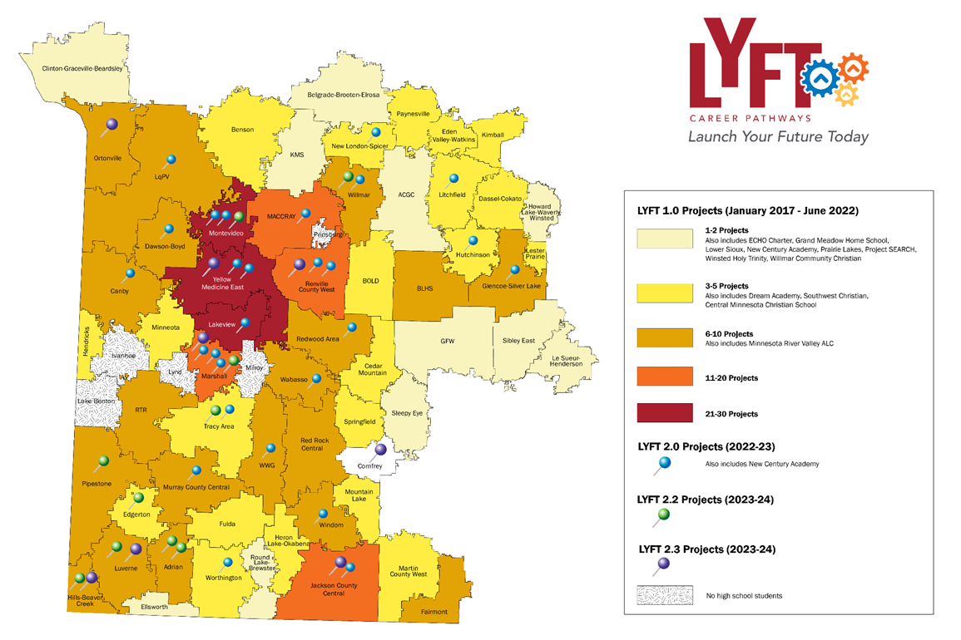
LYFT Career Pathways

Slide 32
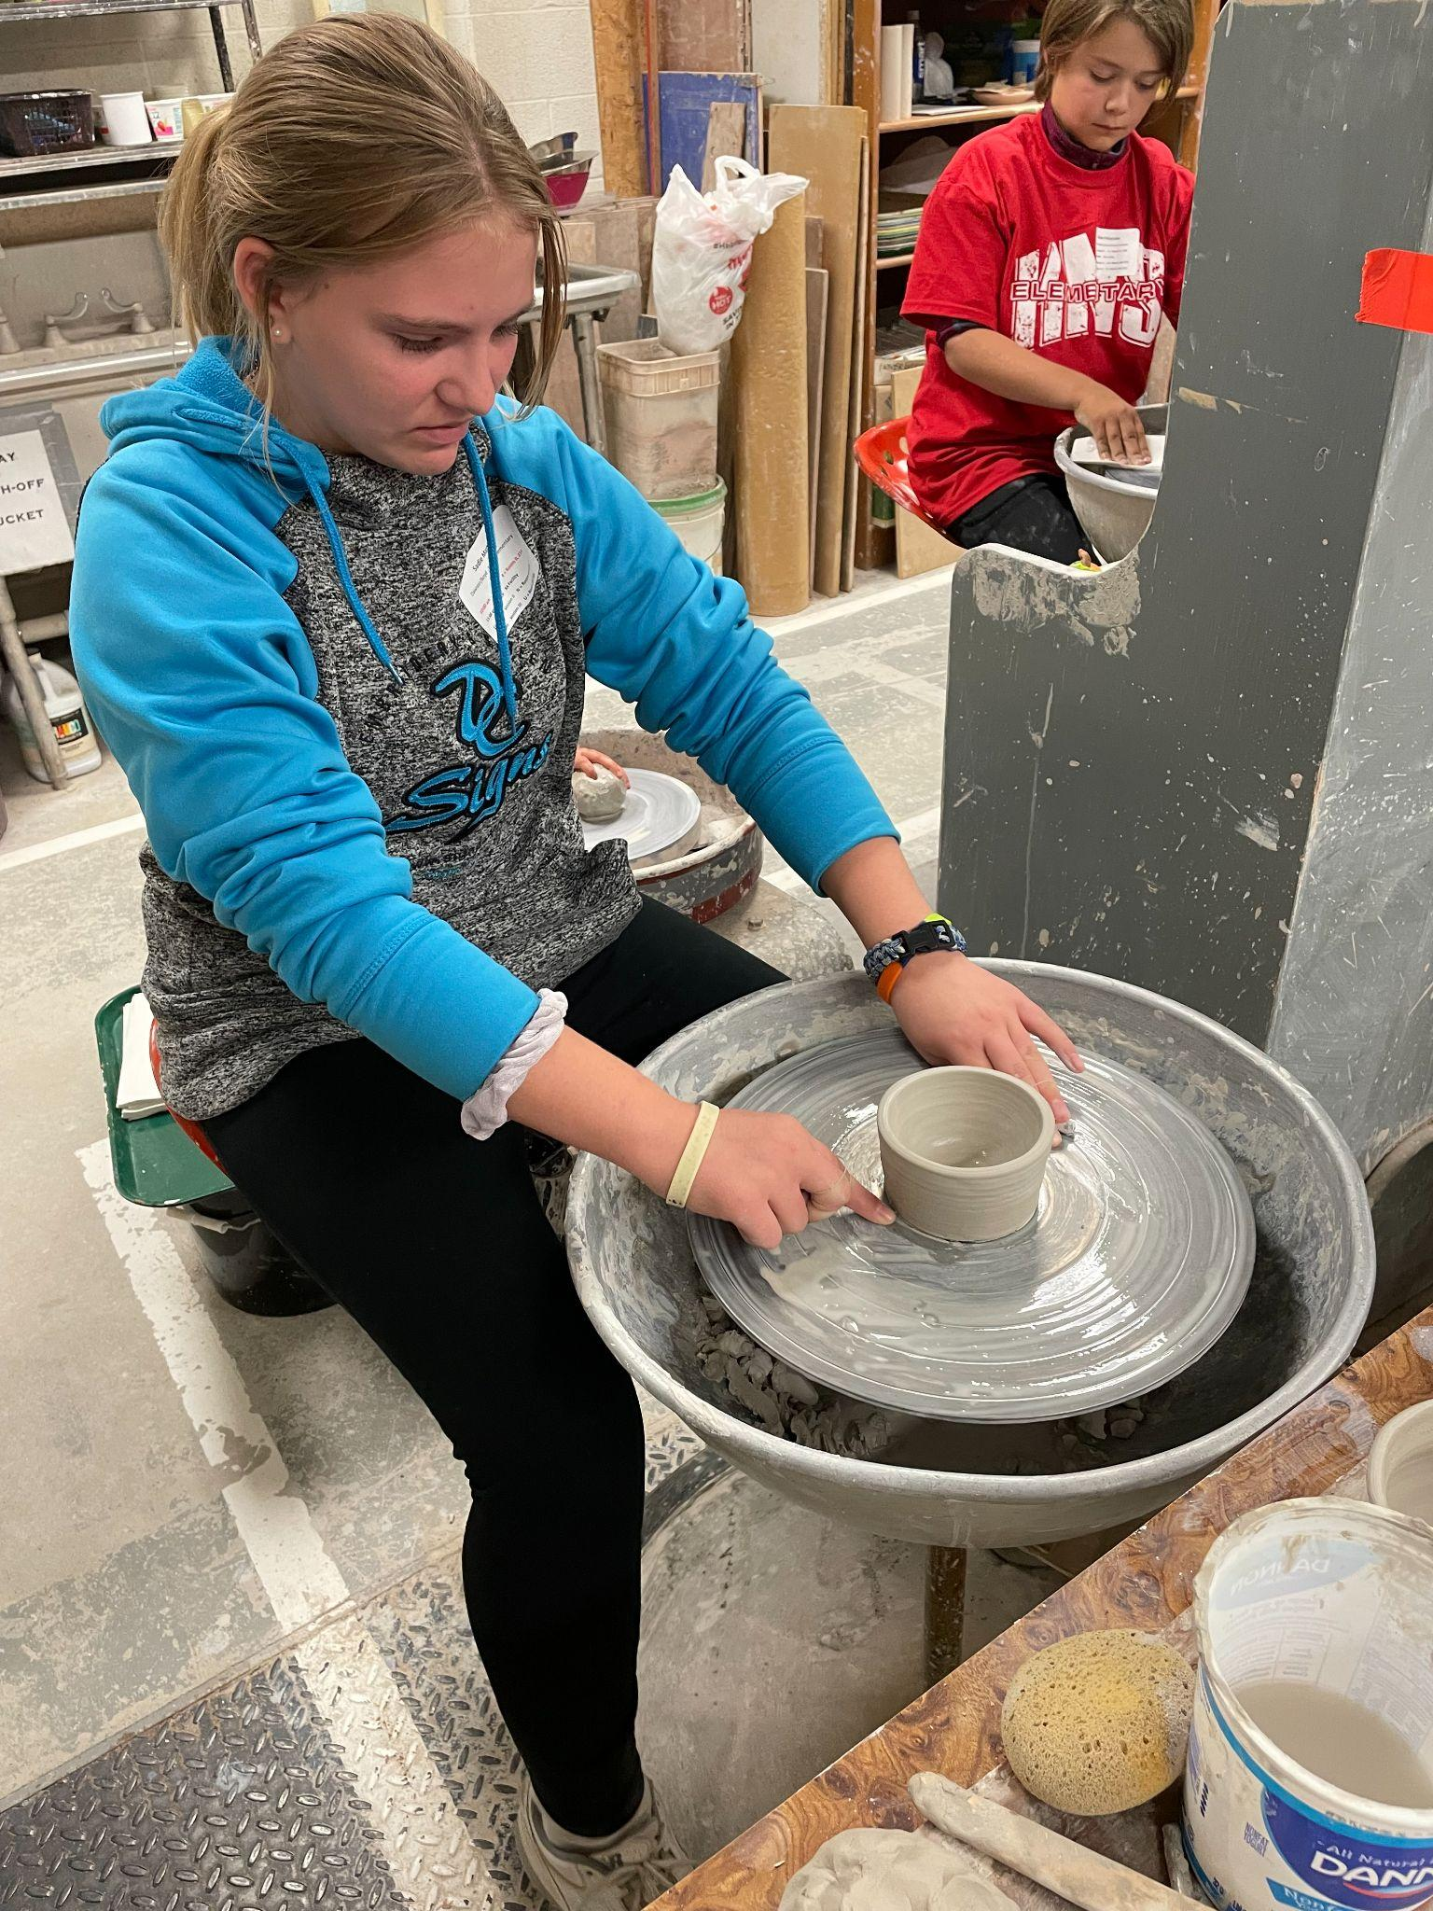
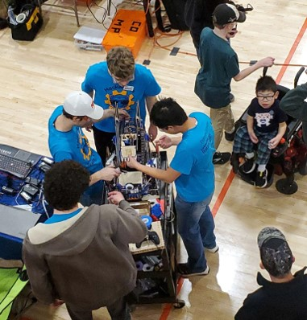
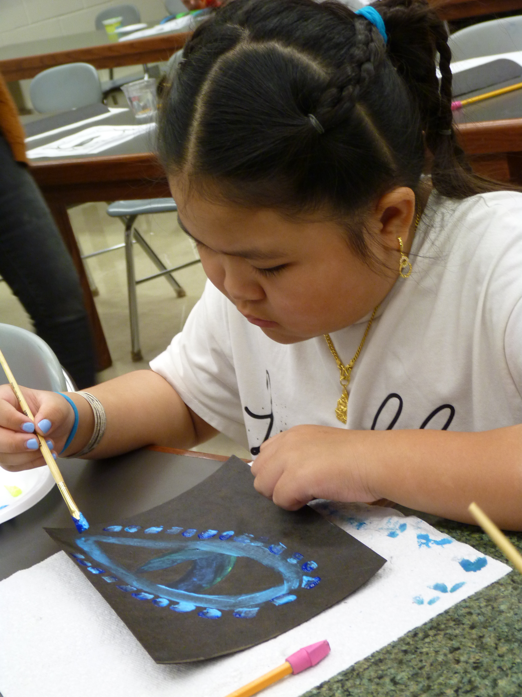
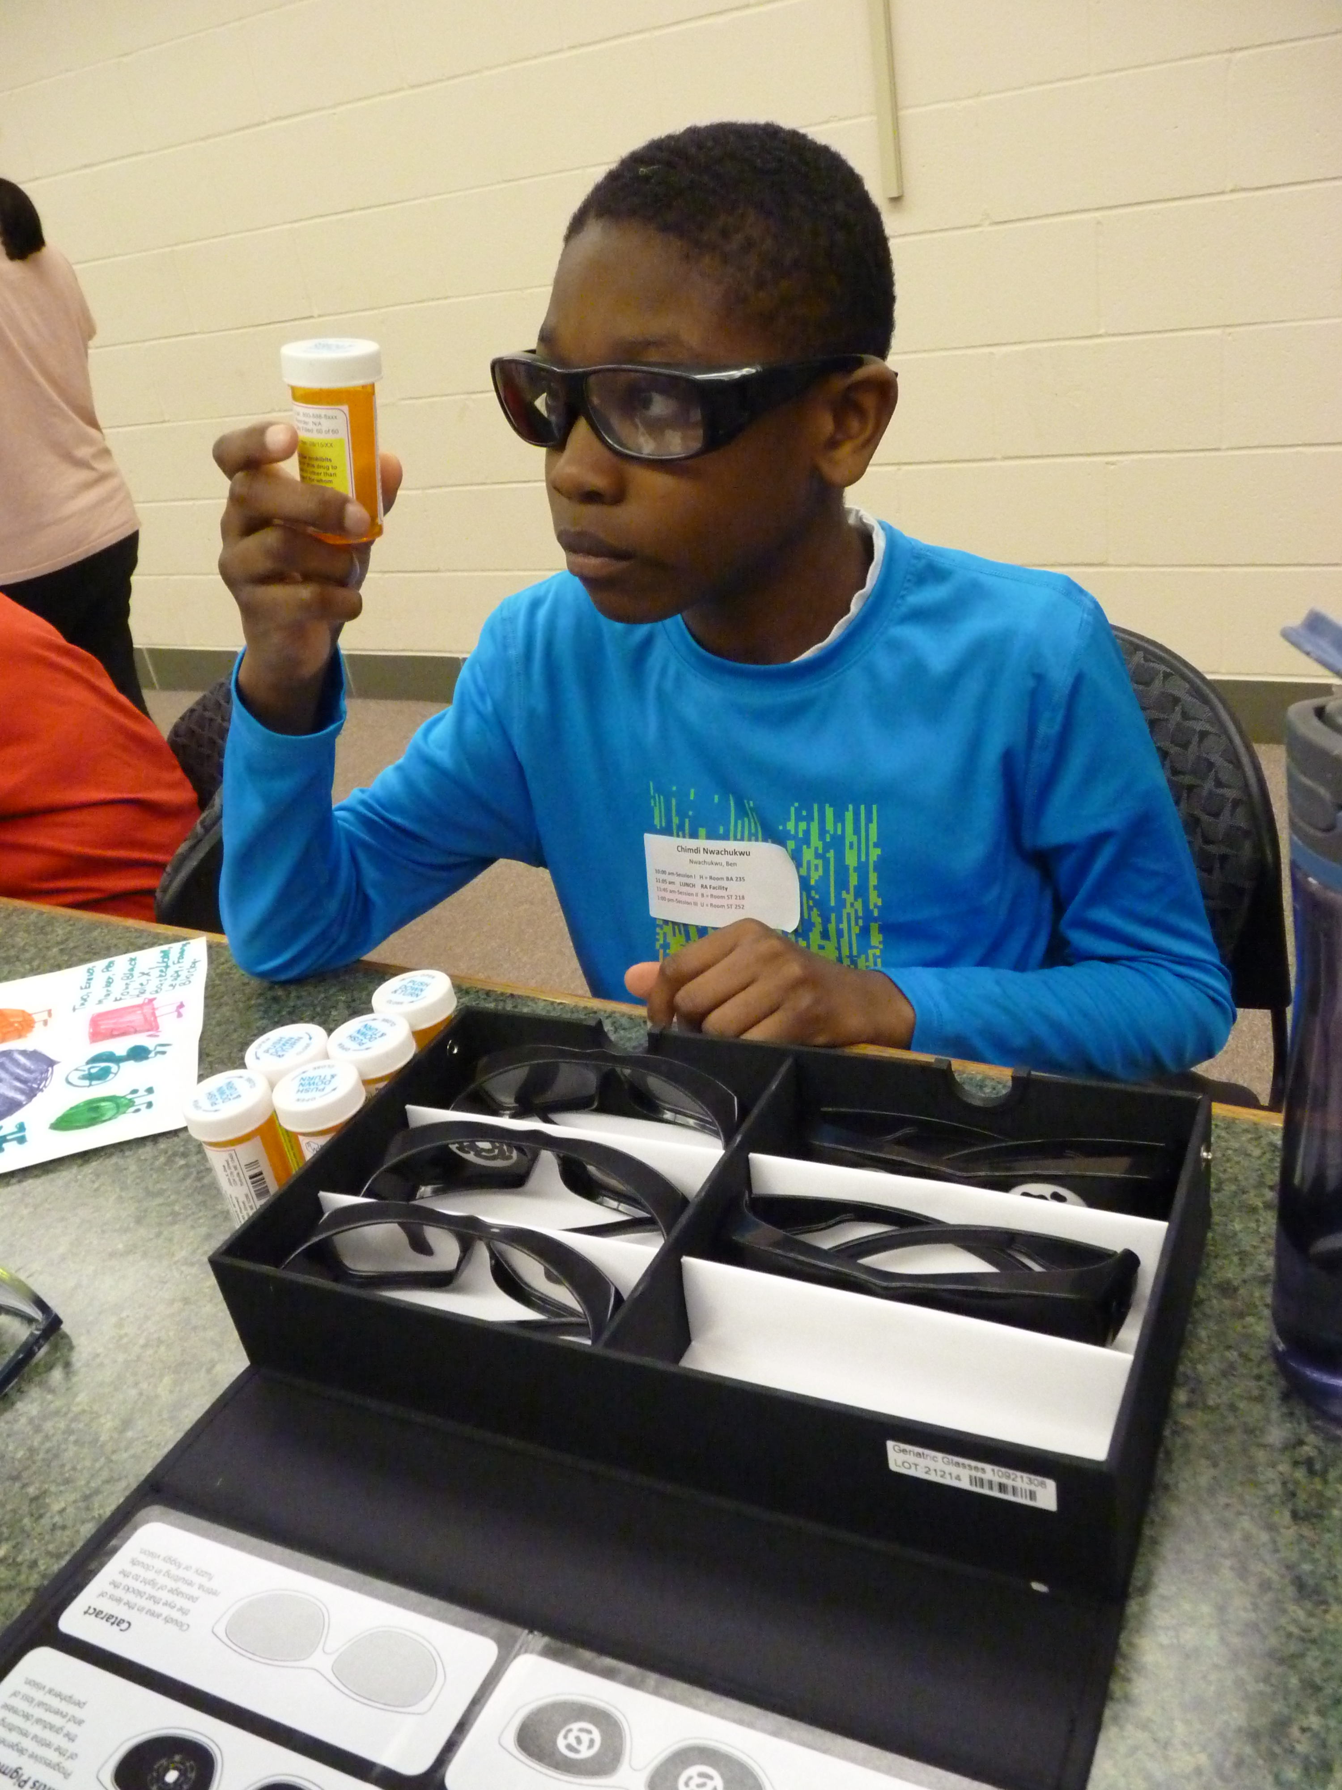
Student Enrichment
Regional events that give K-12 students an opportunity to
further explore areas of interest in a hands-on learning environment.

Slide 33
Over 80 students from 13 schools visited the career exploration lab to explore more than 40 careers.
Our Services
Online career assessment assesses abilities and work values.
Hands-on career exploration with formal and informal assessments.
Written assessment of interests, work skills, and social skills.
Individual follow up staffing to discuss all results.

Slide 34
PBIS
218 schools in southern Minnesota have gone through 2-year training sequence on evidence-based behavior framework
10 PBIS school teams in Southern MN graduated in 2024
13 PBIS school teams are currently participating in cohort training
Tier I Fidelity score for Sustaining Teams is 75% (average)
About 40 PBIS coaches attend regular coach meetings
PBIS created a 5-Part Webinar Series: Student Behavior Tips and Tricks.
PBIS created a SWWC On-Demand Sustainability Course
SRIP trialed Advanced Tier Training with Fulda Schools and began exploration for Advance Tier Work statewide
Lead Regional Coordinator: Allyson Pesek

Slide 35
Technology Solutions
Providing unparalleled levels of service and end-user experiences to SWWC and the members we serve
33 staff members with diverse expertise
Leaders in numerous statewide initiatives
Bringing “enterprise” standards to school district technology

Slide 36
Technology Solutions
Technology Leadership and Support
Supplemental or full technology staffing solution
Solution brings expertise, experience and resiliency to partner districts
Utilized in districts of all sizes
30 districts participating

Slide 37
Technology Solutions
Technology Integration
Building the bridge between educators and technology
Continuous professional mentoring and development
Eight districts participating in regularly scheduled services
Customized Professional Learning Opportunities
Notes:
Virtual Reality and AI initiatives

Slide 38
Technology Solutions
SWWC Wide Area Network Consortium
Connects 90 sites
49 participating school districts
Plum Creek Library System
16 Telecom Consortia statewide

Slide 39
Technology Solutions
Cybersecurity
Security assessments and reports
Security awareness trainings and assessments
Team of experts integrated into participating districts
Management and monitoring of security environment
Notes:
Virtual Reality and AI initiatives

Slide 40
Technology Solutions
E-Rate Coordination
52 school districts and two library consortia representing 53 public libraries
Management of all aspects of E-Rate
Ensure participants understand “what you’re going to get” when filing for E-Rate
Building Long-term relationships
Notes:
Virtual Reality and AI initiatives

Slide 41
Technology Solutions
SWWC Data Privacy Program
81 districts participating
Assists district compliance with the MN Student Data Privacy Law of 2022
Centralizes vetting and Data Privacy Agreement process for all participants
Notes:
Virtual Reality and AI initiatives

Slide 42
Technology Solutions
Technology “Sales”
Dell Aggregated Consortium Purchasing
Sophos Security Solutions Partner
Infosec IQ Partner
3CX Telephone System Partner/Solutions Integrator
Stormwinds Technology Training Partner
Email and Communications Archiving Solutions
Much More!
Notes:
Virtual Reality and AI initiatives

Slide 43
Technology Solutions
Professional Learning
Technology Leadership Workshops
IT² Education Technology Conference
EdTech Connect
Technology Integration Workshops/Trainings
On-Demand Trainings
Notes:
Virtual Reality and AI initiatives

Slide 44
SWWC Foundation
We believe students in the region
deserve innovative and learning-rich educational opportunities so
they can be positioned to learn,
grow and find success.
We are a 501(c)3 public charity and a 509(a)3 Type II supporting organization, created to support student enrichment programs offered through SWWC.
www.swwc.org/foundation

Slide 45
Learn more about us at www.swwc.org

